Slide 1

LSTM-VGG16: A NOVEL & MODULAR MODEL FOR IMAGE CAPTIONING USING DEEP LEARNING APPROACHES
Submitted for Internship/ Industrial training requirements
Of
BTECH & MTECH
In
MATHEMATICS AND DATA SCIENCE
Submitted by:
Ayush Rupapapra (214104026)
Under the guidance
of
Dr. Pushpendra Kumar
DEPARTMENT OF MATHEMATICS, BIOINFORMATICS, AND COMPUTER APPLICATIONS
MAULANA AZAD NATIONAL INSTITUTE OF TECHNOLOGY, BHOPAL

Slide 2
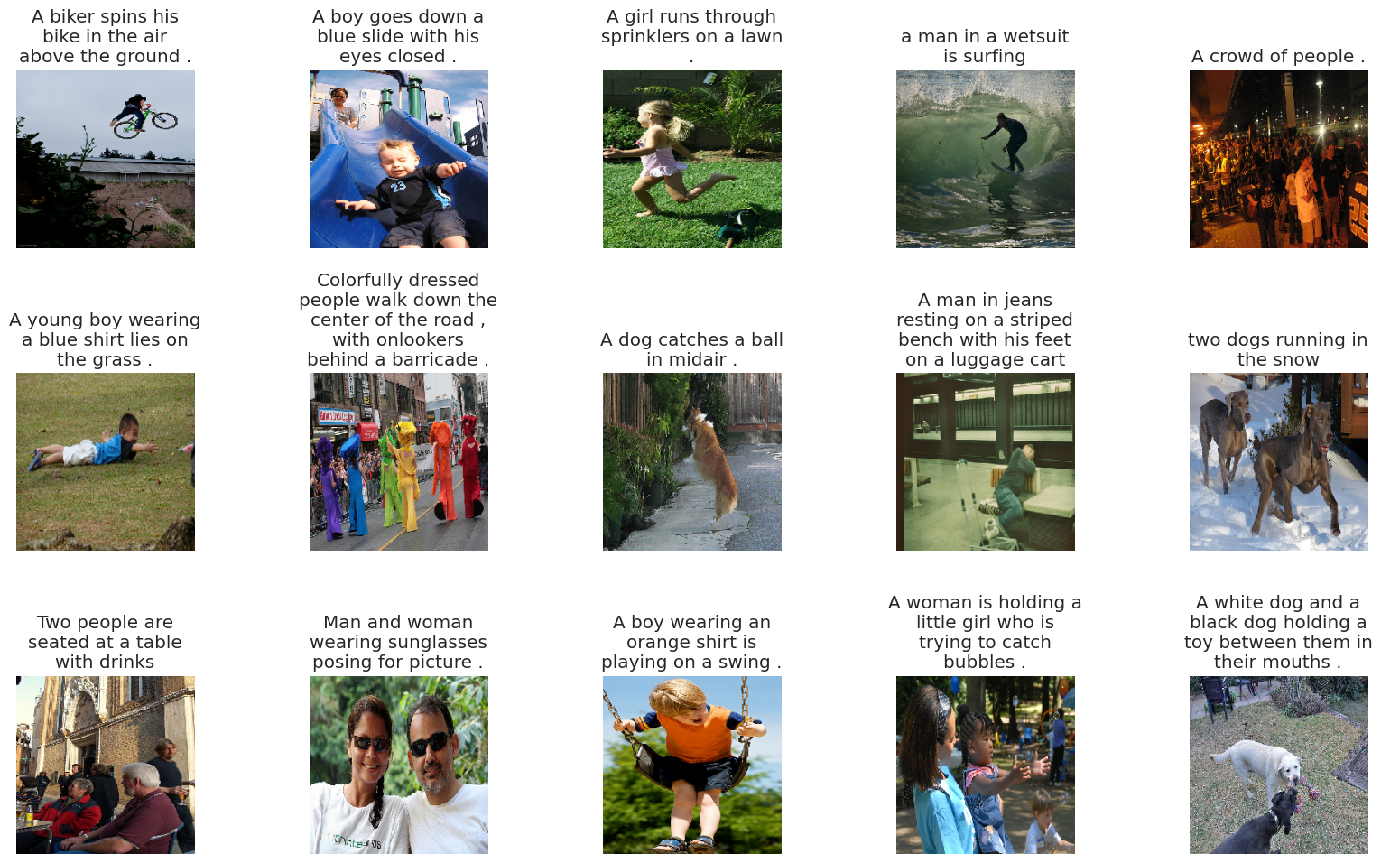
INTRODUCTION
Every day, we encounter numerous images from various sources like the internet, news articles, and advertisements.
While humans can interpret these images without detailed captions, machines require some form of image captions for automatic understanding.
This project aims to develop an end-to-end solution for generating descriptive captions for images using deep learning techniques.

Slide 3
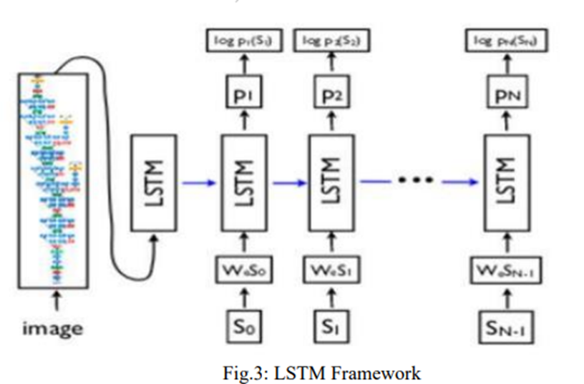
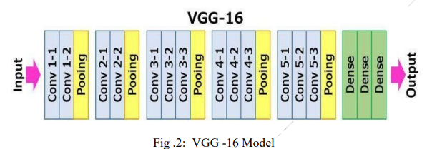
Proposed Approach
To achieve image captioning, our model follows a two-step process.
First, we extract features from the image using a pre-trained VGG16 model.
Then, we generate captions using LSTM (Long-Short Term Memory) networks, which can retain important information over time using memory cells.

Slide 4
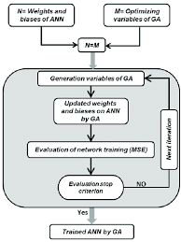
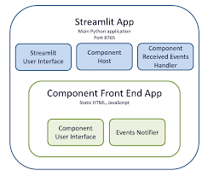
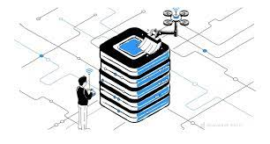
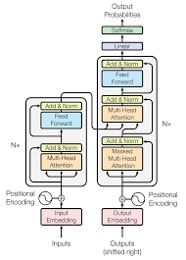
Methodology for Image Captioning
Data Preprocessing
Extract image features
Text preprocessing
Train-Test split
Data generator
Encoder-Decoder Architecture
Load VGG16 model
Encoder :
Image feature layer
Sequence feature layer
Decoder
Training & Optimization
Training model
Evaluation of model
Frontend
User interface using streamlit

Slide 5
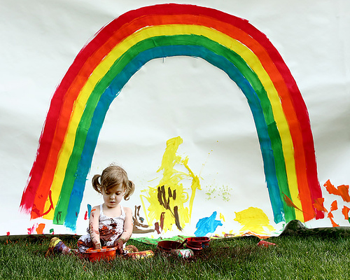
Dataset
I used the Flickr8k Dataset, which contains 8092 photographs and text descriptions.
Dataset contain 5 caption for one Image
Flickr30k Dataset is also available for open source which contain more than 31000 images with text but due to hardware limitation I don’t use it.
Caption
1002674143_1b742ab4b8.jpg,A little girl covered in paint sits in front of a painted rainbow with her hands in a bowl.
1002674143_1b742ab4b8.jpg,A little girl is sitting in front of a large painted rainbow .
1002674143_1b742ab4b8.jpg,A small girl in the grass plays with fingerpaints in front of a white canvas with a rainbow on it.
1002674143_1b742ab4b8.jpg,There is a girl with pigtails sitting in front of a rainbow painting.
1002674143_1b742ab4b8.jpg,Young girl with pigtails painting outside in the grass .

Slide 6
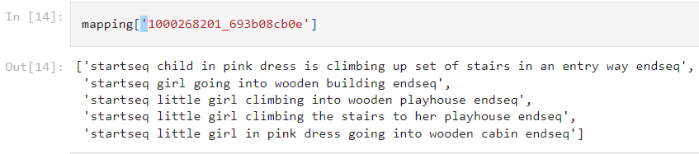
Data Preprocessing
1.Image Feature Extraction
Image reshaping (224, 224)
convert image to array
Preprocess image
Store to feature directory
2. Text preprocessing
Lowercase
Remove digit & special char
Remove additional space
Add startseq & endseq tag
Tokenize the text
3. Train Test Split
In ratio of 9:1
4. Data generator
To get data in batch
To avoid RAM crash

Slide 7
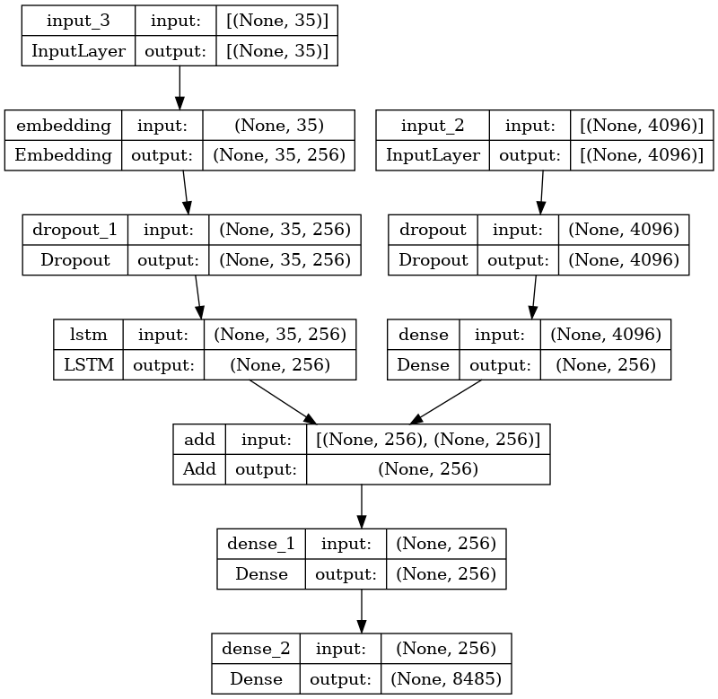
Encoder-Decoder Architecture
1.Load VGG16
Load pretrained VGG16 model except last 2 dense layer
3x3 filter, stride 1,same padding
maxpool layer of
2x2 filter of stride 2.
2. Image Feature Layer
Input image (4096 size)
Dropout layer (0.4)
Dense ( 256 size, relu)
3. Sequences Feature Layer
Input sequence(maxlen)
Embedding
Dropout (0.4)
LSTM (256 size)
4. Decoder
Add fe1 & fe2
Dense layer(256, relu)
Dense layer(8485 size, softmax)

Slide 8
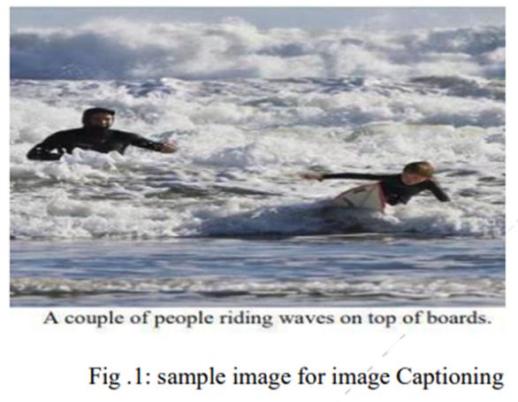
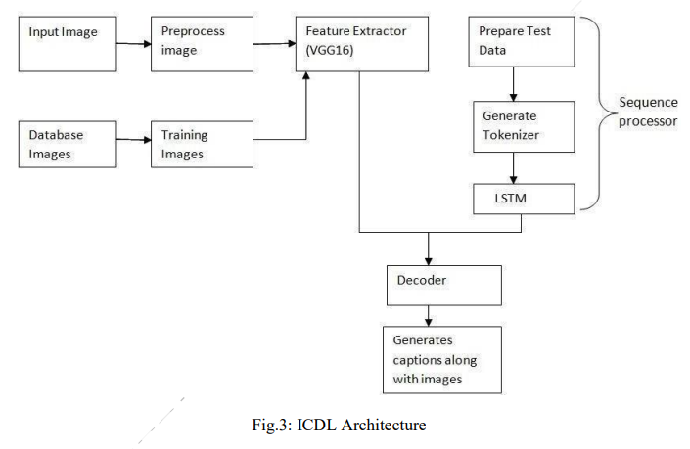

Slide 9
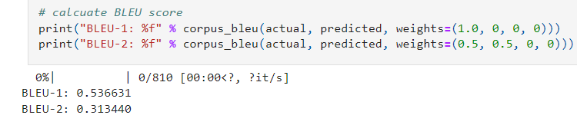
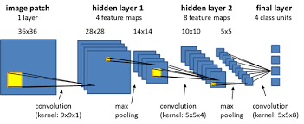
Training & Optimization
Training model
Loss function = categorical_cross
entropy
Optimizer = adam
Epoch = 20
Batch size = 32
Training Loss = 2.1828
2. Evaluation of model
Evaluate using BLEU score

Slide 10
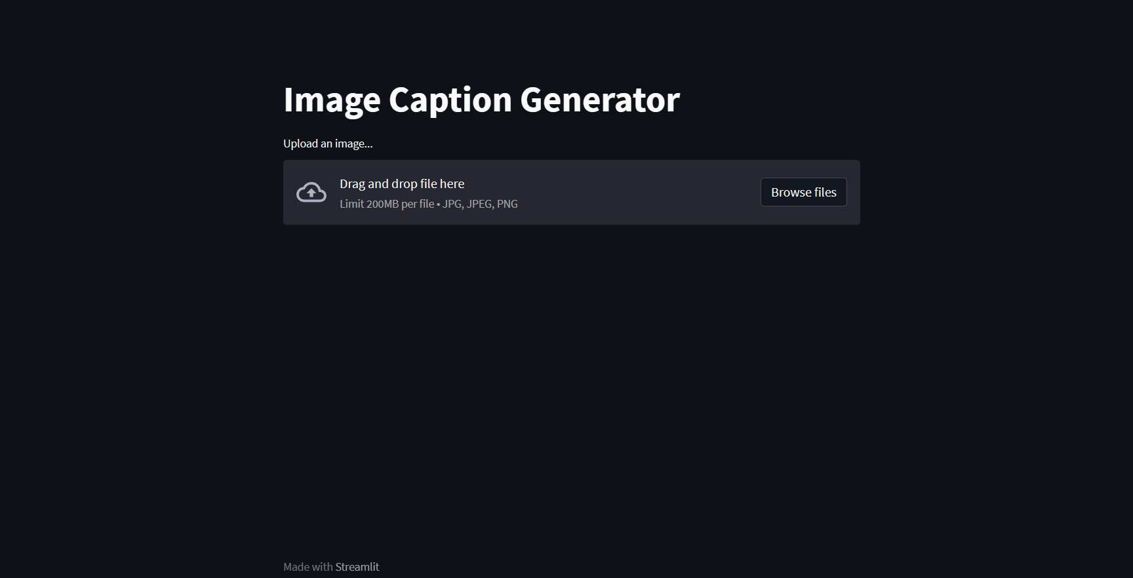
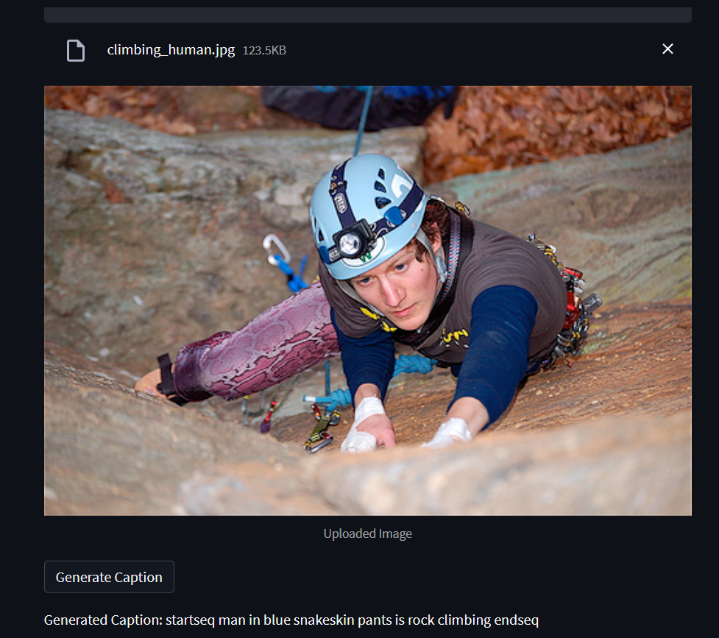
Frontend
Load VGG16, previously trained model & tokenizer
Create file uploader for user to upload image
Write function for extract feature from image by preprocessing
Write function for generate caption

Slide 11
Experimental Results
In our experiments, I used the Flickr8k Dataset, which contains 8092 photographs and text descriptions. The model was trained for multiple epochs(20), achieving a low training loss(2.1828)
I evaluated the model using the BLEU score, with a focus on BLEU-1 score (0.536631).
The results demonstrate the effectiveness of my approach in generating accurate and descriptive captions for images using VGG16-LSTM model.

Slide 12
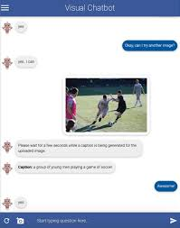
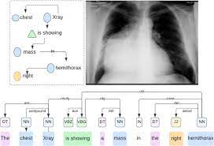
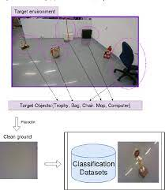
Applications and Future Scope
Media Captioning
Discover how image captioning can revolutionize media accessibility by providing descriptive captions for images in videos, advertisements, and social media.
Medical Imaging
Explore the potential applications of image captioning in medical imaging, such as assisting doctors in generating detailed reports for diagnostic purposes.
Robotics and Automation
Learn how image captioning can enhance the visual perception capabilities of robots and autonomous systems for tasks like object recognition and scene understanding.

Slide 13
Thank You

